Slide 1
B.Tech Mini-Project House Price Prediction

Slide 2
Name of Students and PRN No: (Group No.06) Vaibhav Sontakke (2020BTEIT00074) Sejal Atram (2020BTEIT00067) Kanchan Korde (2020BTEIT00065) Under the Guidance of Prof. Dr. Umesh Chavan

Slide 3

AGENDA
Introduction
Problem Statement
Objective
Flowchart
Methodology
Technology Stack
References

Slide 4
INTRODUCTION
Our project is a machine learning Website, based on certain specifications of your future home it will try to guess the most accurate price.
Information such as city, area, number of bedrooms, number of bathrooms.

Slide 5
PROBLEM STATEMENT
Problem faced during buying a house.
Buying a house is a stressful thing.
Buyers are generally not aware of factors that influence the house prices.
Many problems are faced during buying a house.
Hence real estate agents are trusted with the communication between buyers and sellers as well as laying down a legal contract for the transfer. This just creates a middle man and increases the cost of houses.
=>=--

Slide 6
OBJECTIVE
To construct an model that takes in some factors like city, area, number of bedrooms and based on this factors predicts the price.
To achieve higher accuracy and precision.

Slide 7
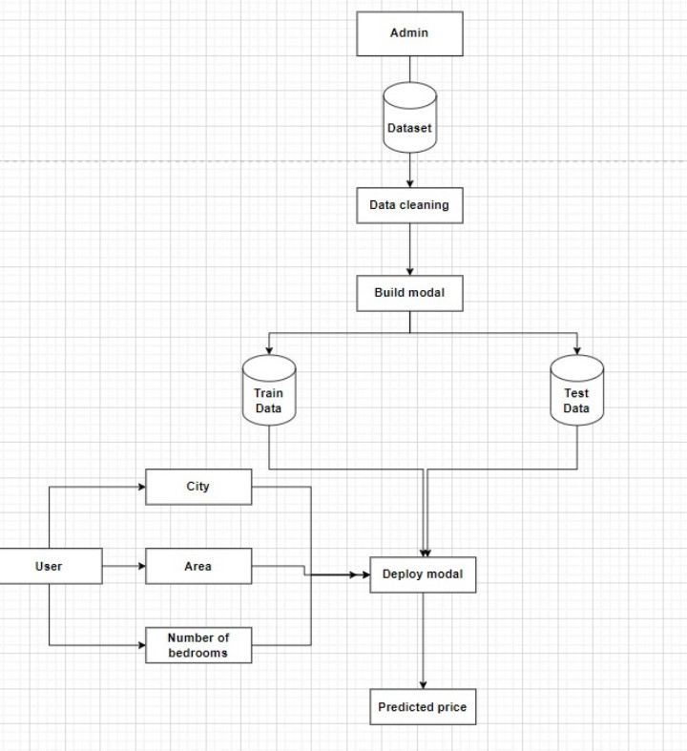
FLOWCHART

Slide 8
METHODOLOGY
Collecting data: first step was to collect data we collected data from different sources & merged them together to form our training data set.
Then we trained the model using different machine learning algorithms but in this case multiple linear regression algorithm gives most presise result .
Based on the generated result we predict the cost of the house.

Slide 9
TECHNOLOGY STACK
Language : Python/HTML/CSS/JavaScript
Domain : Machine Learning
Database : My SQL
Libraries :
Pandas : for data handling
Matplotlib : For data visuavlization

Slide 10
REFRENCES
Anuradha Srinivasaraghavan and Vincy Joseph(2019) Machine Learning, Willey India PVT. Ltd.
https://www.researchgate.net/publication/347584803_House_Price_Prediction_using_a_Machine_Learning_Model_A_Survey_of_Literature/link/600617a7a6fdccdcb8642a88/download.
Dataset link - https://www.kaggle.com/amitabhajoy/bengaluru-house-price-data

